Slide 1

LINEAR REGRESSION AND
NAIVE BAYES ALGORITHM C++
Group Members:
19K-0249 Haris Aqeel
19K-0271 Ayesha Saif
19K-1326 Muhammad Jahanzeb

Slide 2

Linear regression and Naive Bayes algorithm C++
CONTENT
PART 01
PART 03
Introduction
What is Naïve Bayes?
WORKING
PART 02
PART 04
What is Linear Regression?
CONCLUSION
WORKING

Slide 3

Linear regression and Naive Bayes algorithm C++
INTRODUCTION
The project is able to predict the specie of an iris flower up to a minimum accuracy of 90% using Naïve Bayes Theorem.
The two methods used in the project are (1) Linear Regression & (2) Naïve Bayes theorem
Each of these method uses both a different strategy and a different set of data to come to the mathematically most probable outcome possible.

Slide 4

Linear regression and Naive Bayes algorithm C++
Linear Regression
Linear regression is a basic and commonly used type of predictive analysis. The overall idea of regression is to examine two things: (1) does a set of predictor variables do a good job in predicting an outcome (dependent) variable? (2) Which variables in particular are significant predictors of the outcome variable, and in what way do they–indicated by the magnitude and sign of the beta estimates–impact the outcome variable? These regression estimates are used to explain the relationship between one dependent variable and one or more independent variables. The simplest form of the regression equation with one dependent and one independent variable is defined by the formula y = c + b*x, where y = estimated dependent variable score, c = constant, b = regression coefficient, and x = score on the independent variable.
Naming the Variables. There are many names for a regression’s dependent variable. It may be called an outcome variable, criterion variable, endogenous variable, or regressand. The independent variables can be called exogenous variables, predictor variables, or regressors.
Three major uses for regression analysis are (1) determining the strength of predictors, (2) forecasting an effect, and (3) trend forecasting.

Slide 5
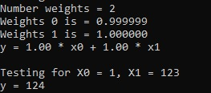
Linear regression and Naive Bayes algorithm C++
Linear Regression
WORKING
STEP 1: Assume a mathematical relationship between the target and the predictor(s). “The relationship can be a straight line (linear regression) or a polynomial curve (polynomial regression) or a non-linear relationship (non-linear regression)”
STEP 2: Create a scatter plot of the target variable and predictor variable (simplest and most popular way).
Image for post
STEP 3: Find the most-likely values of the coefficients in the mathematical formula

Slide 6
Linear regression and Naive Bayes algorithm C++
Linear Regression
WORKING
Linear Regression:
y = a_0 + a_1 * x
we want to find the best a_0 and a_1 for the dataset
Cost Function: Need a cost-function and want to minimize that (minimization problem now)
Mean Squared Error = 1/n * (Sum (y_predi - yi)^2 from i = 1 to n)
MSE is just a type of error we can choose from
Gradient Descent
Used to minimize MSE cost function to find best a_0 and a_1
Big learning rate = big jumps, small learning rate = super small jumps (longer)
If cost function not convex can be stuck in a local minima (not happening in linear regression)
Need gradient, so we take partial derivative with respect to a_0 and a_1.
Calculus is used to find partial derivative
How to update
a -> learning rate
new_a0 = a0 - (2a/n)* (Sum (y_predi - yi) from i = 1 to n)
new_a1 = a1 - (2a/n)* (Sum (y_predi - yi)*xi from i = 1 to n)
How to calculate score (R2 score)
Definition is: proportion of the variance in the dependent variable that is predictable from the independent variable(s)

Slide 7
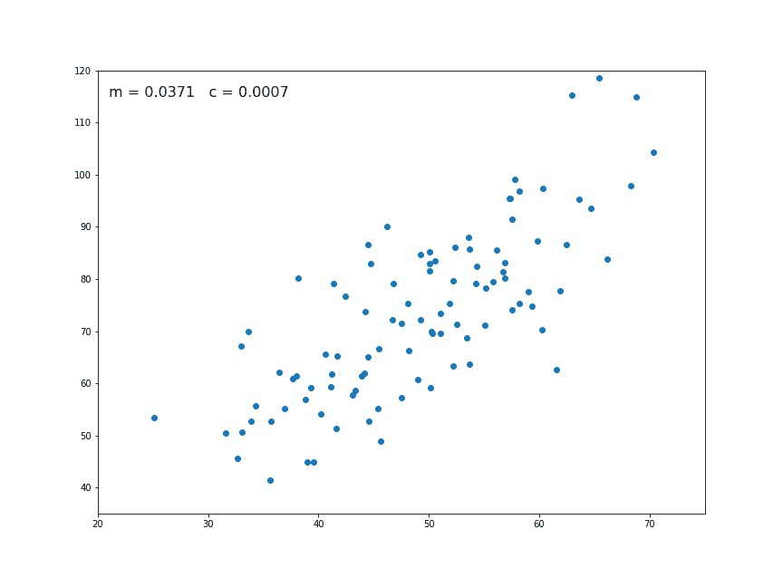
Linear regression and Naive Bayes algorithm C++
Linear Regression
FUNCTIONALITY
Regression analysis comprises of the entire process of identifying the target and predictors,finding the relationship, estimating the coefficients, finding the predicted values of target, and finally evaluating the accuracy of the fitted relationship.

Slide 8

Linear regression and Naive Bayes algorithm C++
Naïve Bayes
Naive Bayes classifiers are linear classifiers based on Bayes’ theorem. The model generated is probabilistic
It is called naive due to the assumption that the features in the dataset are mutually independent
Being relatively robust, easy to implement, fast, and accurate, naive Bayes classifiers are used in many different fields.

Slide 9
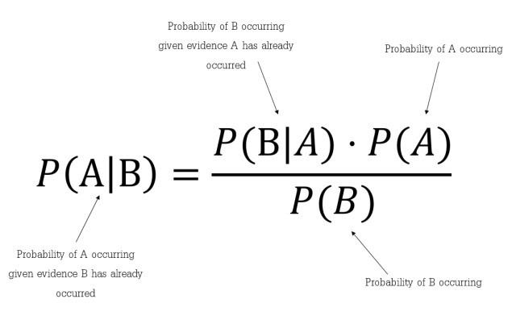
Linear regression and Naive Bayes algorithm C++
Naïve Bayes
WORKING
Bayes’ Theorem

Slide 10

Linear regression and Naive Bayes algorithm C++
Naïve Bayes
WORKING
The Student will be a pass if he wears a “red” color dress on the exam day.
By Bayes Theorem, P(Pass| Red) = P( Red| Pass) * P(Pass) / P (Red).
From the values, let us assume P (Red|Pass) = 3/9 = 0.33, P(Red) = 5/14 = 0.36, P( Pass)= 9/14 = 0.64. Now, P (Pass| Red) = 0.33 * 0.64 / 0.36 = 0.60
In this way, Naive Bayes uses a similar method to predict the probability of different class based on various attributes.

Slide 11
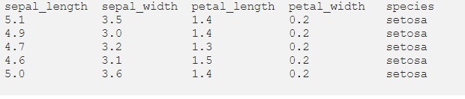
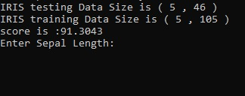
Linear regression and Naive Bayes algorithm C++
Naïve Bayes
WORKING

Slide 12



Linear regression and Naive Bayes algorithm C++
CONCLUSION
In conclusion, the program is able to predict an outcome via two different methods using the data set provided to certain level of acceptable accuracy. This kind of prediction is very useful when a large amount of data is provided where each data member is independent of the other and an estimate has to be made of the most likely outcome such as in weather forecasting, marketing effectiveness, pricing and promotions on sales of a product, etc. and as in our case, predicating the specie of a flower.

Slide 13

Linear regression and Naive Bayes algorithm C++
CONCLUSION
In conclusion, the program is able to predict an outcome via two different methods using the data set provided to certain level of acceptable accuracy. This kind of prediction is very useful when a large amount of data is provided where each data member is independent of the other and an estimate has to be made of the most likely outcome such as in weather forecasting, marketing effectiveness, pricing and promotions on sales of a product, etc. and as in our case, predicating the specie of a flower.

